Slide 1


8 Bayesian Inference
EOE Postgraduate Courses
Multi-sensor Data Fusion
wangjingqi@njust.edu.cn
Notes:
贝叶斯推理

Slide 2
Contents
8.1 Introduction
8.2 Bayesian Analysis
8.3 Probability Model
8.4 A posteriori Distribution
8.5 Model Selection
8.6 Computation

Slide 3
8.1 Introduction
Basic premise of Bayesian statistics （贝叶斯统计）
all unknowns are treated as random variables
the knowledge of these quantities is summarized via a probability distribution.
Main advantages of using Bayesian statistics （贝叶斯统计主要优点）
only known coherent system for quantifying objective and subjective uncertainties.
providing principled methods for the model estimation and comparison and the classification of new observations.
providing a natural way to combine different sensor observations.
providing principle methods for dealing with missing information.
powerful common representational format（有力的公共表示格式）
The corresponding probability distributions act as a powerful common representational format.

Slide 4
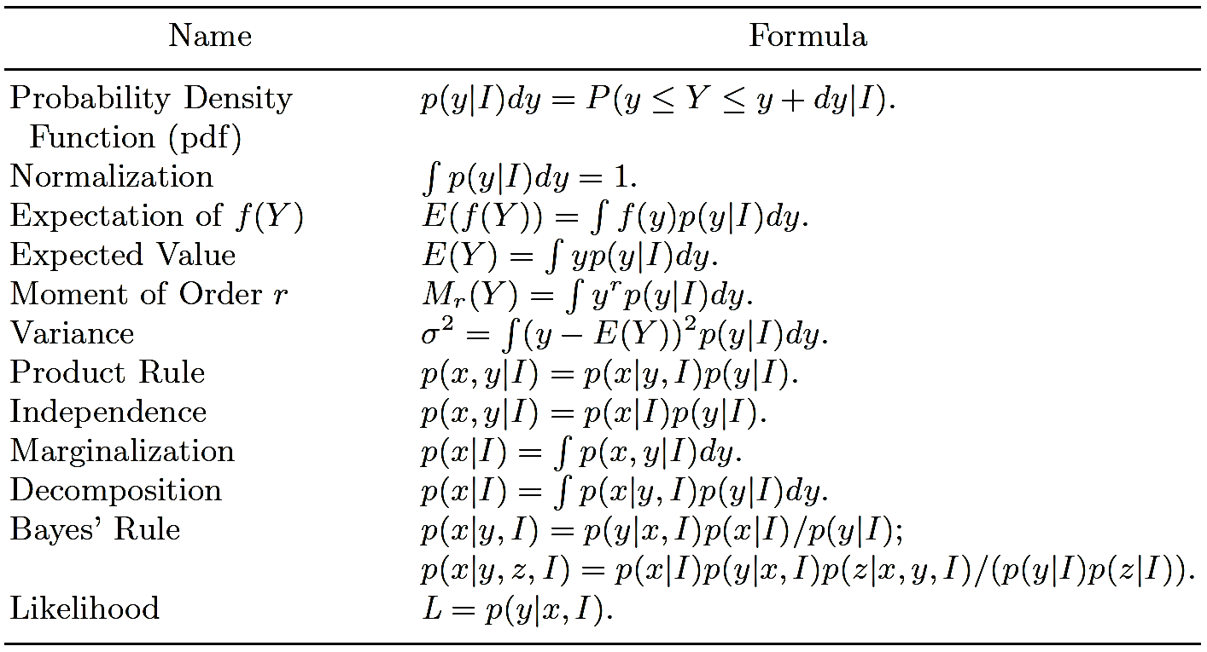
Basic Formulas Used in Bayesian Inference （贝叶斯推理的主要公式）
Table 8.1. Basic Formulas Used in Bayesian Inference
X and Y denote two random variables whose instantiations are, respectively, x and y.
I describes any background information.

Slide 5
8.2 Bayesian Analysis（贝叶斯分析）
Quantities in Bayesian statistics — the observed data, y and any missing data, z, unknown parameters, θ, and models, M.
Process of Bayesian analysis（贝叶斯分析步骤）
Probability Model —— a joint probability distribution capturing the relationship among all the variables under consideration.
A Posterior Distribution — summarize all the information regarding the different quantities of interest in a set of a posteriori distributions. Typically the a posteriori distribution is a conditional probability density function (pdf) p(θ|y, I).
Model Selection. （模型选择） —— evaluate the appropriateness of using a given model.

Slide 6
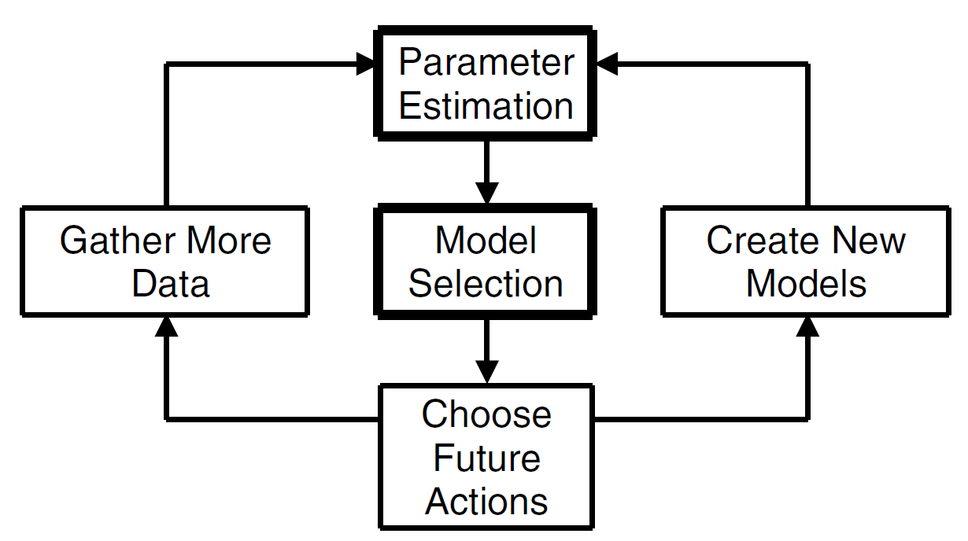
Example 8.1. Scientific Theories. —— Part of the scientific process in which data is collected and modeled.
Fig. 8.1. The role played by Bayesian inference in the scientific process.
Parameter estimation（参数估计） —— to infer what the model parameters might be given the model and the data.
Model selection （模型选择）—— to infer what model is probably closer to the correct model given the data.

Slide 7
8.3 Probability Model
Full probability model, or joint probability distribution
（全概率模型，或联合概率分布）
write down the likelihood function（似然函数） and multiply it by a priori distribution （先验分布）of all the unobserved variables and parameters.
likelihood function: the probability of the observed data given the unknowns
assume the observed data, y, comes from a parametric pdf p characterized by the parameters θ. Then the joint pdf can be represented as
θ — come from some a priori distribution, π, with parameters λ;
I — denotes all of our relevant background knowledge.
λ — hyperparameters （超参数）to be differentiated from the parameters θ.

Slide 8
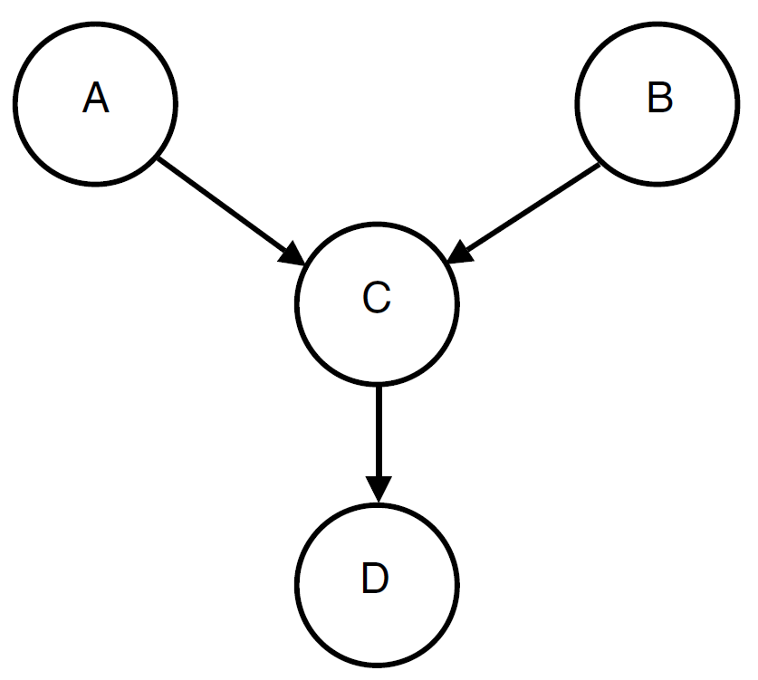
Graphical model（图形化模型）
The input data, y, the missing data, z, and the model parameters, θ, are represented as nodes in a graph.
Relationships and influences between the nodes are then represented as straight lines, which link the nodes.
Parents and child
pa(C) = {A,B}
ch(A) = C, ch(B) = C
pa(D) = C
Markov Blanket（马尔科夫毯） —The parents and child of a node, plus the children’s other parents, constitute a Markov Blanket.
mk(A) = {B,C}.
Fig. 8.2. a simple graphical model with nodes {A,B,C,D}.

Slide 9
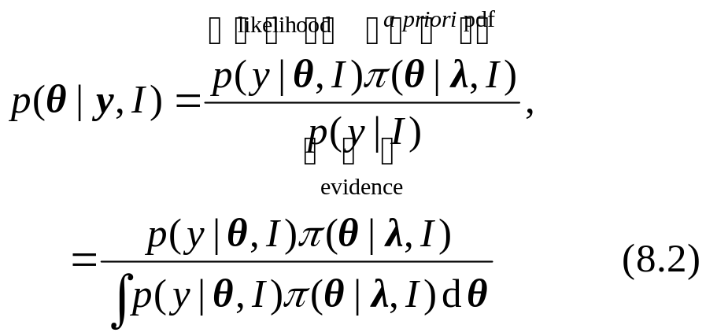
8.4 A Posteriori Distribution（后验分布）
The Bayesian inference is drawn by examining the probability of all possible values of the parameters, θ, after considering the data, y.
If, Hyperparameters（超参数）λ, are known，then we obtain the a posteriori pdf through the application of Bayes’ Theorem（贝叶斯定理）
p(y|I) = p(y|θ, I)π(θ|λ, I)dθ — the evidence and is a normalizing constant which is required so that p(θ|y, I) will integrate to one.
The evidence is obtained by integrating out all the variables, except for the observed data, y, from the joint distribution.

Slide 10
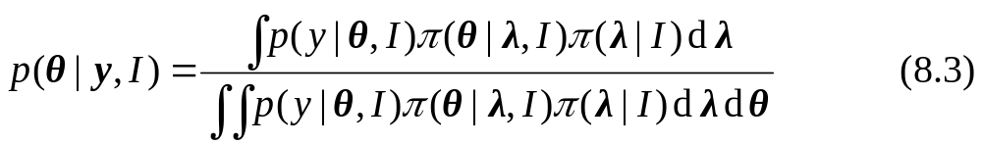
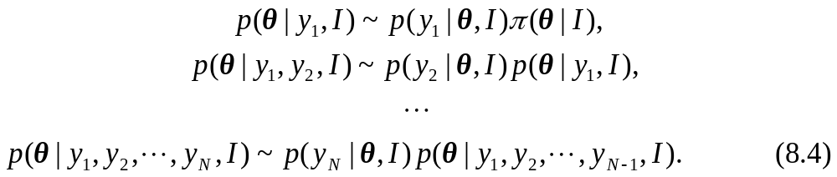
If λ are not known，then we may remove them by integration
where π(λ|I) is the a priori pdf for λ.
The hyperparameters, λ, are removed by integration.
Systematic update of the a posteriori distribution :

Slide 11
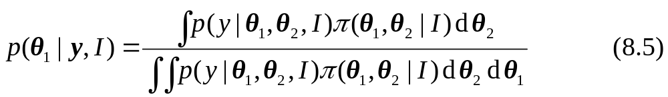
Nuisance parameters (多余参数)
more than one unknown parameter, e. g. θ = (θ₁, θ₂).
only interested in one component, say θ₁, those unknown quantities that are not of immediate interest, but are needed by the model, are known as nuisance parameters.
Removing nuisance parameters by integration
Challenges of the Bayesian statistics
The development of a model, p(y|θ, I)π(θ, I) —— must effectively capture the key features of the underlying physical problem;
The necessary computation required for deriving the a posteriori distribution.

Slide 12
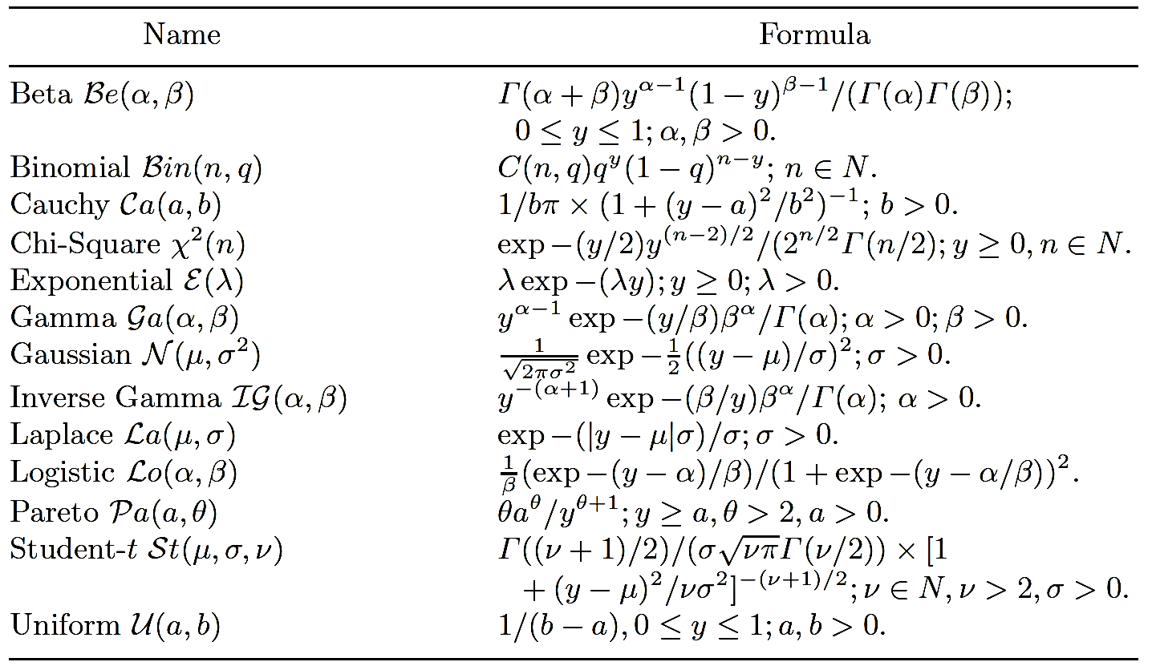
8.4.1 Standard Probability Distribution Functions
（标准概率分布函数）
for developing adequate models for the likelihood p(y|θ) and the a priori and a posteriori distributions, p(θ| I) and p(θ|y, I).
Table 8.2. Important Univariate Distributions f(y)

Slide 13
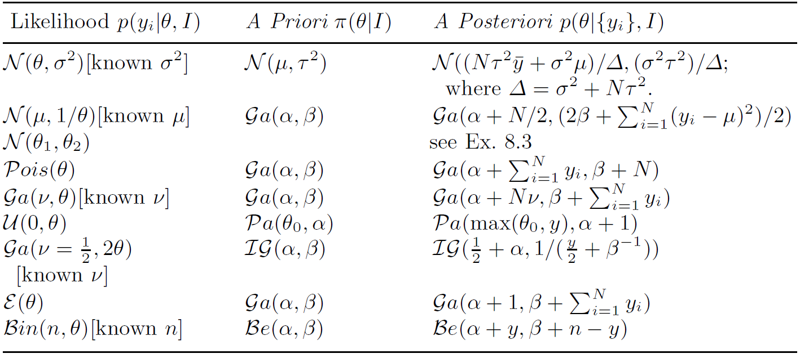
8.4.2 Conjugate Priors （共轭先验）
a conjugate prior — a family of distributions for π(θ|I) that has the same functional form as the posteriori function.
when a conjugate prior is used, the functional form of the a posteriori distribution is the same as that of the a priori distribution.
enjoying the greatest mathematical and computational advantage.
Table 8.3. Conjugate Distributions

Slide 14
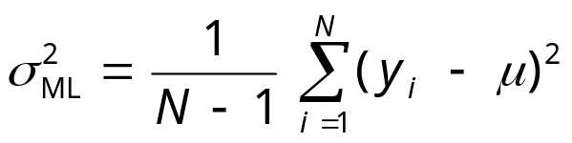

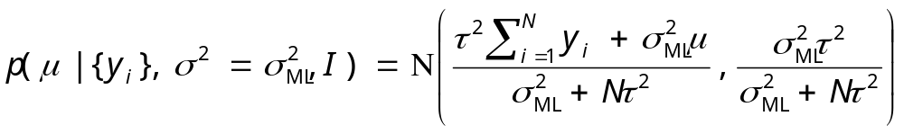
Example 8.2. Conjugate Prior for a Gaussian Distribution with Known Variance （具有已知方差的高斯分布的共轭先验）
N independent samples y_{i}, i ∈ {1, 2, . . .,N}, with the Gaussian distribution N(μ, σ²) with unknown mean μ.
The variance σ² is assumed known and is set equal to the unbiased maximum likelihood value:
choosing a conjugate prior N(μ, τ²)
the a posteriori pdf p(μ |{y_{i}}, I) is

Slide 15
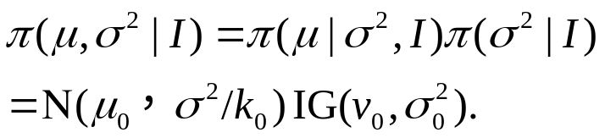
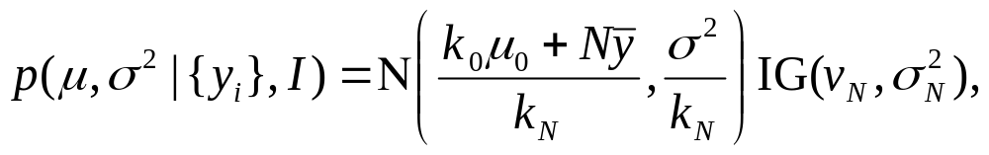
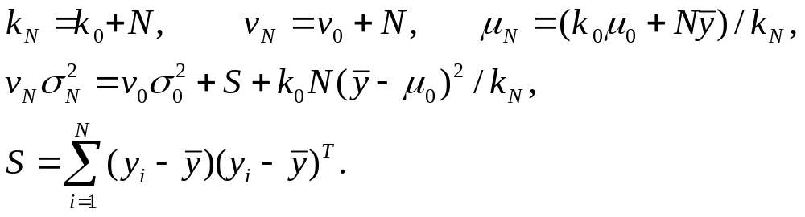
Example 8.3. Conjugate Prior for a Gaussian Distribution with Unknown Mean and Unknown Variance （未知均值、未知方差的高斯分布的共轭先验）
both the mean μ and the variance σ² are unknown.
The a priori distribution for μ and σ² is
The joint a posteriori pdf is
where

Slide 16
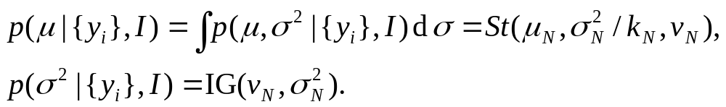
The marginal distributions（边缘分布) p(μ|{y_{i}},I) and p(σ²|{y_{i}},I) are found, respectively, by integrating out σ² and μ ,

Slide 17

8.4.3 Non-Informative Priors （无信息先验）
designed for those situations without any knowledge of what the true distributions should be.
The simplest non-informative a priori distribution for a given variable θ : π(θ|I)∝1. —— uniform distribution
a priori pdf is not invariant to scale changes.
Jeffrey’s a priori pdfs which are invariant to changes of variables
where I(θ) = −E(d² log p(y|θ)/dθ²) is the Fisher information.
the reference and the maximal data information prior (MDIP) distributions

Slide 18
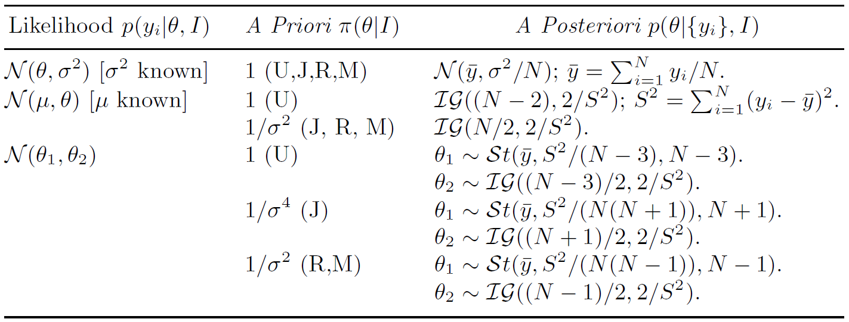
Table 8.4. Non-Informative Priors Distributions for a Guassian distribution
Note: The use of non-informative priors is controversal especially their use for multivariate distributions.

Slide 19
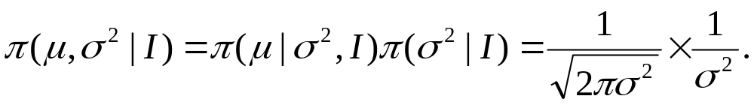
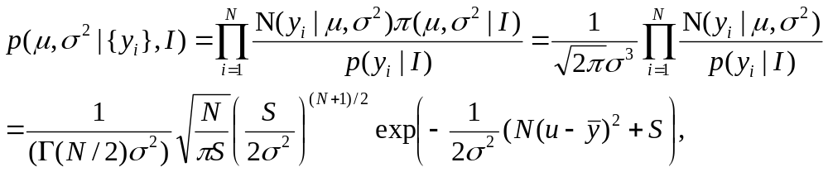
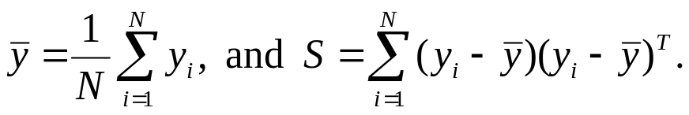
Example 8.4. Non-Informative Prior for a Gaussian Distribution with Unknown Mean and Unknown Variance
（应用于未知均值、未知方差的高斯分布的无信息先验）
both the mean μ and the variance σ² are unknown.
Assuming no a priori knowledge of μ and σ² , a non-informative distribution is
The joint a posteriori pdf is
where

Slide 20

8.4.4 Missing Data （删失数据）
two kinds of unknowns: parameters and hyperparameters, missing data
parameters and hyperparameters ——characterize the entire population of observations and fixed in number.
the missing data —— usually directly related to the individual data and its dimensionality increase as more and more data are observed.
“observed-data likelihood” （观测数据似然）, defined as L = p(y|θ, I), which can be obtained by integrating out the missing data from the “complete data likelihood”（完全数据似然）,

Slide 21
Bayesian analysis for missing data problems can be achieved coherently through integration:
z are treated as random variables
the integration required for eliminating missing data is no different from that required for eliminating nuisance parameters（多余参数） and unknown hyperparameters.

Slide 22
Expectation-maximization (EM) algorithm （期望最大化算法）
EM algorithm is an iterative method for finding maximum likelihood or maximum a posteriori (MAP) estimates of parameters in statistical models, where the model depends on unobserved latent variables.
The EM iteration alternates between performing an expectation (E) step, and a maximization (M) step.
E-step creates a function for the expectation of the log-likelihood evaluated using the current estimate for the parameters.
M-step computes parameters maximizing the expected log-likelihood found on the E step. These parameter-estimates are then used to determine the distribution of the latent variables in the next E step.

Slide 23
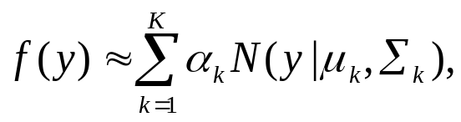
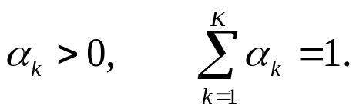
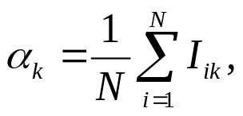
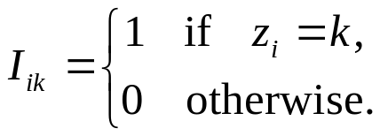
Example 8.5. Gaussian Mixture Model
In GMM, we model a probability density function, θ = f(y), as a sum of K Gaussian distributions N(μ_{k},Σ_{k}), k ∈ {1, 2, . . .,K}:
where α_{k}, μ_{k}, Σ_{k}, k ∈ {1, 2, . . .,K}, are unknown to be learnt from a set of training data (θ_{i}, y_{i}), i ∈ {1, 2, . . .,N}, subject to the constraints
We associate a “hidden” variable z_{i} with each y_{i}. z_{i} can only take on the values {1, 2, . . .,K}. θ_{i} = f(y_{i}) was generated by randomly choosing z_{i} and drawing y_{i} from the Gaussian N(μ_{k},Σ_{k}), where k = z_{i} .
where

Slide 24
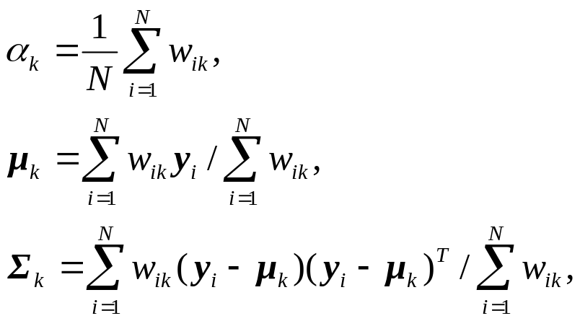

EM algorithm to calculate the parameters (α_{k}, μ_{k}, Σ_{k}), k ∈ {1, 2, . . ., K}, by repeating the following steps until convergence.
E-step. Calculate the a posteriori probability of the hidden variable, z_{i}, given the input data y_{i}, i ∈ {1, 2, . . .,N}, and using the current parameter values α_{k}, μ_{k}, Σ_{k} :
M-step. Update the parameters α_{k}, μ_{k}, Σ_{k} :
where

Slide 25
Three major drawbacks of EM/GMM algorithm
1. The EM algorithm converges to a local minimum. →The results are sensitive to the initial conditions used.
2. The EM algorithm is liable to fail as a result of singularities（奇点）, or degeneracies（退化）, in the input data.
may be substantially reduced by carefully choosing the initial conditions and “regularizing” the covariance matrices.
3. The GMM suffers from the “curse of dimensionality” — As the dimensionality of the input data increases, the number of input vectors which are required to specify μ_{k} and Σ_{k} increases exponentially。
traditional solution has been to constrain the structure of the covariance matrices.
Use a mixture of probabilistic PCA’s, instead of a mixture of Gaussians.
□

Slide 26

The EM algorithm to perform PCA (principle component analysis)
Example 8.6. PCA Using the EM Algorithm
PCA—— to find a L-dimensional linear projection that best represents a set of M-dimensional input vectors y_{i}, i∈{1, 2, . . .,N} .
conventional PCA —— to find the L dominant eigenvectors u_{l}, l∈{1, 2, . . .,L} , of the sample covariance matrix Σ, where
∼O(NM²) operations
EM algorithm
∼O(LNM) operations per iteration

Slide 27
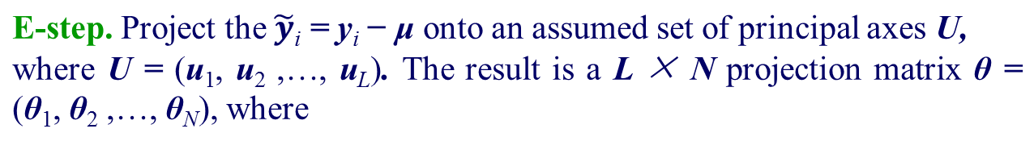



EM algorithm
and
a M×N matrix of input measurements with their mean μ removed.
M-step. Find new principal axes U which minimize the squared reconstruction error. The new principal axes are
□

Slide 28
8.5 Model Selection （模型选择）
We have more than one model, and focus on assessing the fitness of each model and conducting model selection.
Bayesian model selection procedure —— The comparison between a “null” model, M = 0, and an alternative model, M = 1.
The corresponding joint pdf is:
If y depends on the models through their parameters, then
π(θ_{m}|M = m, I) is the a priori distribution for θ_{m}, given the model M = m
π(M = m|I) is the a priori probability of the model M = m.

Slide 29

The a posteriori probability for the model M = m is proportional to the evidence,
maximum a posteriori (MAP)
The choice of the a priori distribution, π(M = m|I), is dependent on the application.
Laplace approximation ——a simple approximation to the a posteriori pdf, p(y|θ,M = m, I).
Notes:
maximum a posteriori (MAP)

Slide 30
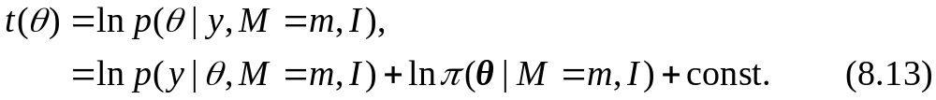
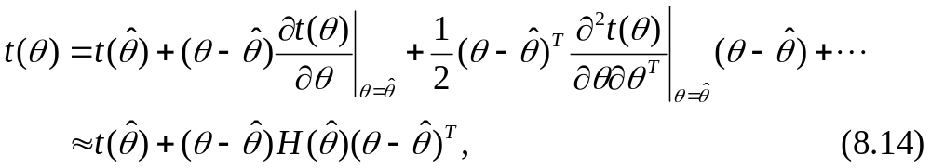
8.5.1 Laplace Approximation
Assuming that p(θ|y,M = m, I) has only one mode, we approximate with a Gaussian function.
Let
Expanding t(θ) about ˆθ, its maximum a posteriori (MAP) value,
where H(ˆθ) is the Hessian matrix（海塞矩阵）, the second derivative of t(θ) evaluated at ˆθ.
Notes:
8.5.1 Laplace Approximation

Slide 31
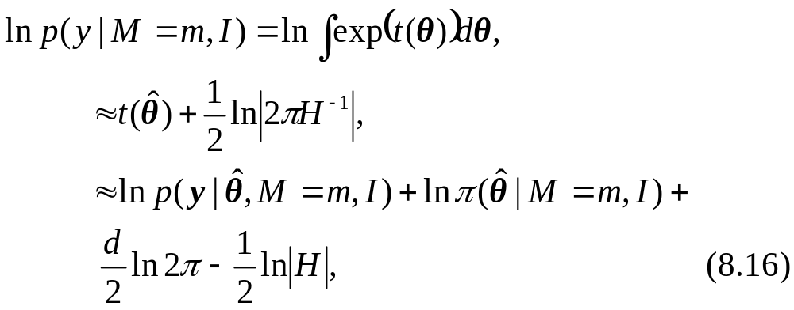
Substituting (8.14) into the logarithm of (8.9) and integrating over θ, yields
where d is the dimensionality of the parameter space θ.
Notes:
8.5.1 Laplace Approximation

Slide 32
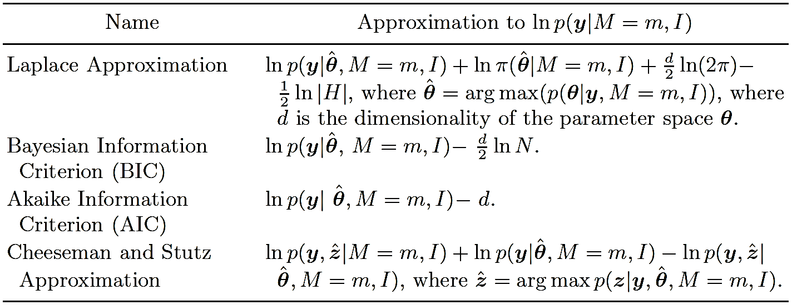
Table 8.5. Approximations to the Natural Logarithm of the Bayesian Evidence ln p(y|M = m, I)

Slide 33
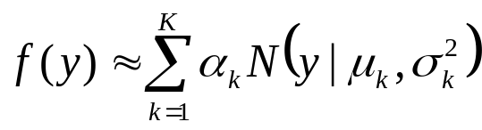
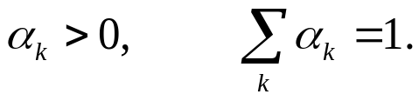
To select the optimum number in a Gaussian mixture model (GMM)
Example 8.7. Gaussian Mixture Model
a function f(y) using a sum of K Gaussian pdf’s:
subject to the constraints
How to select K —— the optimum number of Gaussians？
Supplied by the user;
determined by selecting the best GMM (with the largest Bayesian evidence) from a set of candidate models, each model having a different number of Gaussians.
Notes:
Traditionally the user supplies the value of K. However, if the user is
unable to supply a value for K, it may be determined by selecting the best
GMM from a set of candidate models, each model having a different number
of Gaussians. After optimally fitting the parameters of the different models
(using the EM algorithm) we find the optimum value for K (i. e. the optimum
model) by choosing the model with the largest Bayesian evidence.

Slide 34
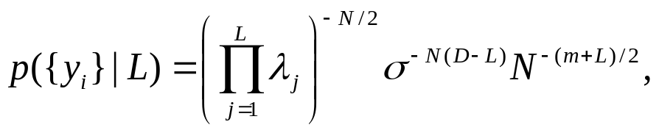

To estimate the intrinsic dimensionality of a given data set {y_{i}}.
Example 8.8. Intrinsic Data Dimensionality.
A central issue in pattern recognition is to estimate the intrinsic dimensionality d of the input data {y_{i}}.
By interpreting PCA within a Bayesian framework, we are able to derive the following BIC approximation for the evidence:
where D is the dimension of the input data and m = DL − L(L + 1)/2.
The intrinsic dimenionality of the input data is then defined as
Notes:
A central issue in pattern recognition is to estimate the intrinsic dimensionality d of the input data {y_{i}}.

Slide 35
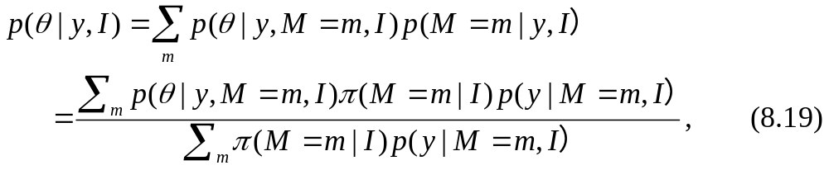
8.5.2 Bayesian Model Averaging (BMA)
In BMA we do not select a single “optimal” model. Instead we take the uncertainty involved in selecting an optimal model into consideration by averaging over the a posteriori distribution of multiple models.
The a posteriori pdf, p(θ|y, I), is
where π(M = m|I) is the a priori probability of the model M = m.
In general, BMA has a better performance than any single model that could
reasonably have been selected. M is limited to a small number of models.
Notes:
8.5.1 Laplace Approximation

Slide 36

Thank you for your attention!

